Slide 1
WELCOME TO POWER POINT PRESENTAION
CLASS : ‘V’ A
SUB : ENGLISH
TOPIC :RIP VAN WINKLE

Slide 2

PEAK OF A HILL
FOOT OF A HILL

Slide 3
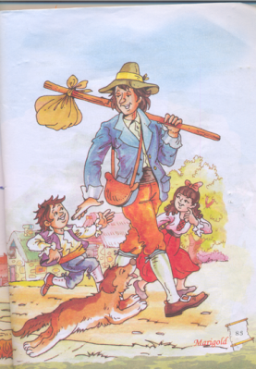
Many years ago at the foot hills
of kaat – skill mountains
was a little village2. In the village lived
a simple good natured fellow
named Rip Van Winkle.
He was a kind neighbour ready to help
anyone. Everyone in the village liked him.

Slide 4
Opposite Words
Foot hills – peak of the hills
Simple – complex
Like - dislike
Word meanings
Neighbour = a person who lives
next to us

Slide 5
Rip Van Winkle taught
the children, how to fly kites3 playing marbles
and told them many stories.
So children loved him.

Slide 6
Present tense Past tense
TEACH
FLY
TELL
TAUGHT
FLEW
TOLD
SINGULAR PLURAL
CHILD
MARBLE4
STORY
CHILDREN
MARBLES
STORIES

Slide 7
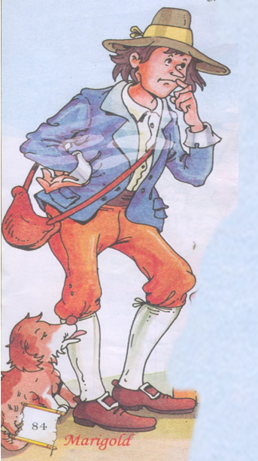
But the problem was
Rip was very lazy5. He never worked
in his farm and idled away his time.
Rip’s constant companion was his dog called WOLF

Slide 8

WORD MEANINGS
CONSTANT - CONTINUOUSLY
COMPANION 6- A PERSON WITH WHOM YOU SPEND
TIME WITH

Slide 9
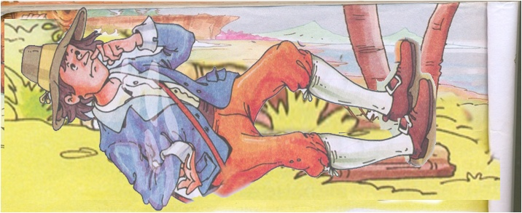
One day Rip walked on and on
and reached the highest part of the mountains7.He was tired after his long climb
and he lay down and started day dreaming
EVERYBODY IN THE VILLAGE LIKED HIM

Slide 10
WORD MEANING
DAY DREAMING - TO HAVE A DREAM DURING DAY TIME
present tense
past tense
woke up
carried
made
wake up
carry8
make

Slide 11
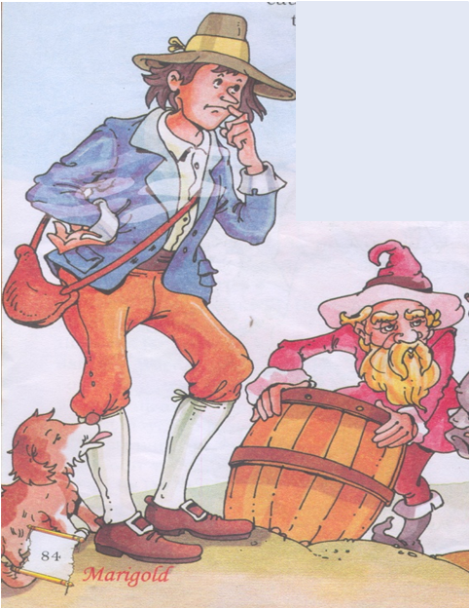
While he was day dreaming
suddenly he woke up and he heard
a voice calling Rip Van Winkle,
He saw a short old man
with thick hair and beard
walking with a barrel9
he made signs to carry
The barrel for him.

Slide 12
PRESENT TENSE
PAST TENSE
Hear
sign
carry
Heard
Signed
carried
opposite words
highest - lowest

Slide 13
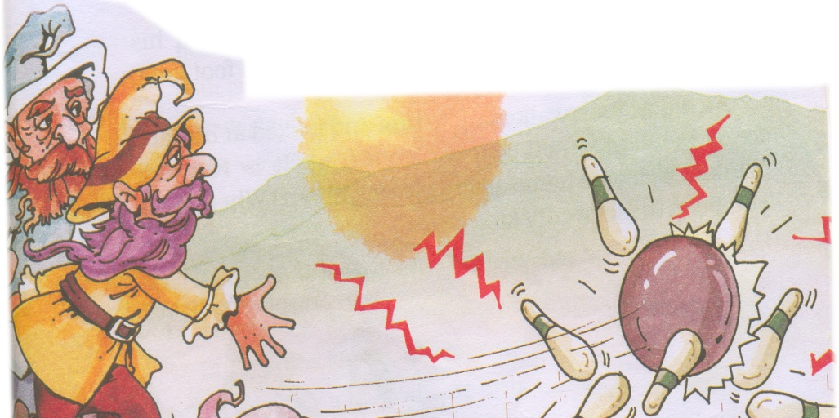
Rip and the old man walked
together . They reached
a place ,where Rip saw some more
odd looking men playing nine pins10

Slide 14


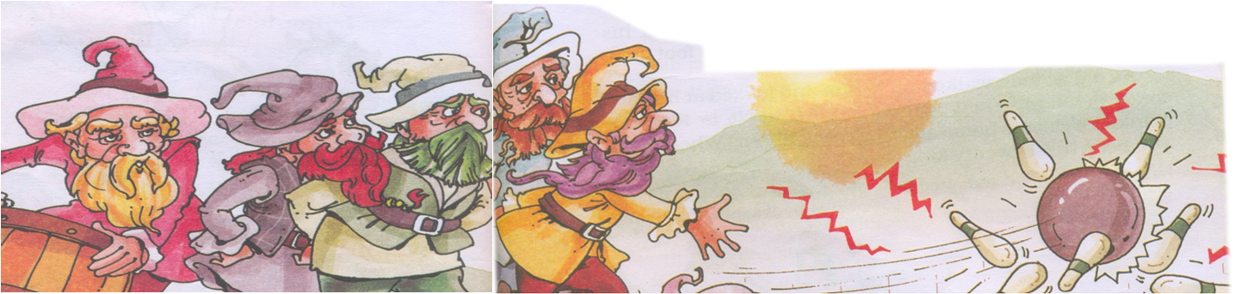
The old people were playing
nine pins very seriously

Slide 15

Rip’s companion emptied
the barrel into glasses and made Rip to drink it11
Rip was afraid and obeyed.
He drank few more glasses
and fell asleep

Slide 16
word meanings
Companion – a friend, or a pet
with whom we spend time
Descending- to climb down

Slide 17
When Rip woke up, it was morning12. He could not find his dog.He started descending the mountain to go back to his village.

Slide 18

WORD MEANINGS
Descend - to climb down
Descend X ascend
OPPOSITE

Slide 19
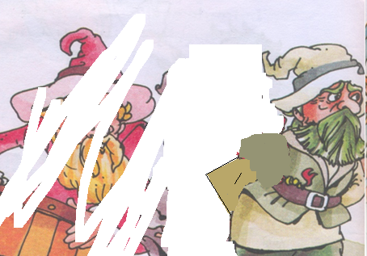
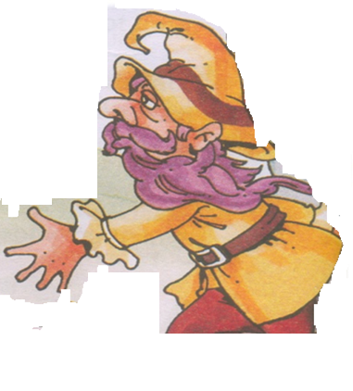
When he reached the village, the villagers stared at him. They could not recognise him. He had a long white beard and a rinkled face13.
13

Slide 20
WORD MEANINGS STARED– TO LOOK AT CONSTANTLY Wrinkle - to have foldings

Slide 21

When Rip touched
his chin he was astonished.
He found his beard grown a foot long
and it was all white in colour14.

Slide 22

AN OLD MAN LOOKED AT HIS FACE AND EXCLAIMED, “ It is Rip van winkle”. He asked him, “ Rip where have you been all these twenty long years?”

Slide 23

Astonished-surprise exclaim- asking with surprise
WORD MEANINGS

Slide 24

1. Where did rip van live? 2.What kind of man was rip? 3.Why did children love rip? 4.Who was rip`S COMPANION? 5.WHERE DID RIP GO ONE DAY?
ANSWER THE FOLLOWING

Slide 25
Find the word meanings of 1 companion,2. astonishment 3. STARE , 4.EXCLAIM
OPPOSITES
DESCEND X
SIMPLE X
LIKE X

Slide 26

SINGULAR
PLURAL
COMPANION
BARREL
PRSENT
PAST
HURRY
OBEY
SLEEP

Slide 27


THANK YOU
&
HAVE A NICE DAY

